Slide 1

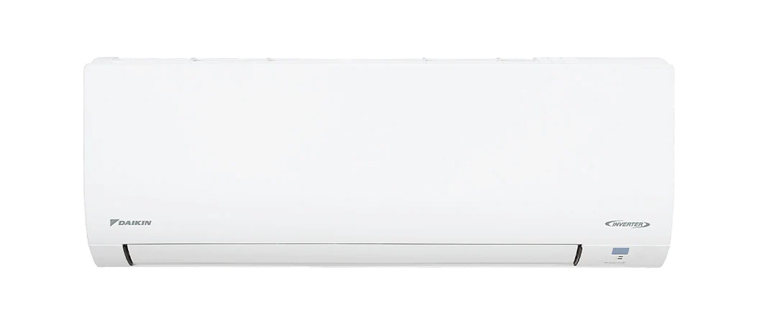
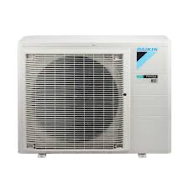
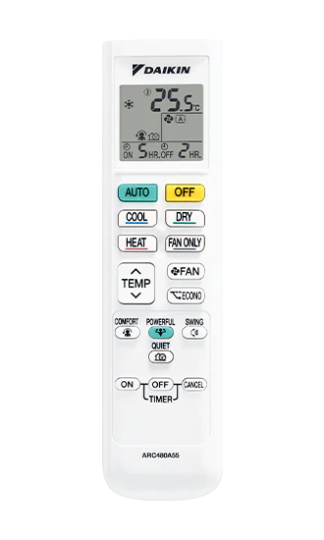

Light Series
Cooling: 7.1 kW
Heating: 8.0 kW
Installation Included
Quiet Mode
Eco Mode

